Slide 1

Mastering Blockchain Third Edition
Chapter 3, Symmetric Cryptography

Slide 2
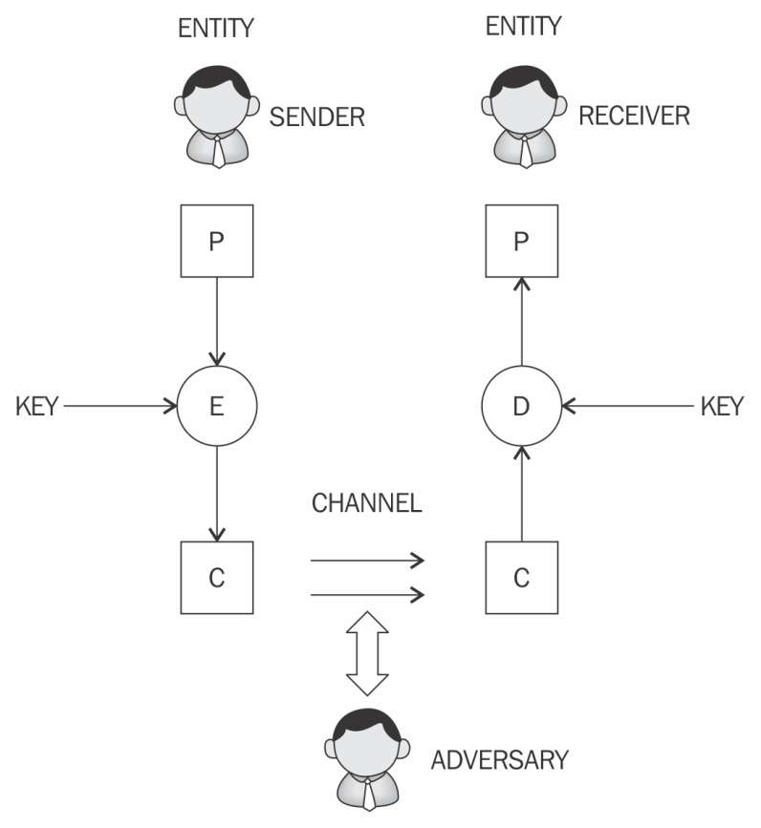
Cryptography
A generic cryptographic model is shown here.
P, E, C, and D represent plaintext, encryption, ciphertext, and decryption, respectively.

Slide 3
Cryptography services
Confidentiality
Integrity
Authentication
Non-repudiation
Accountability

Slide 4
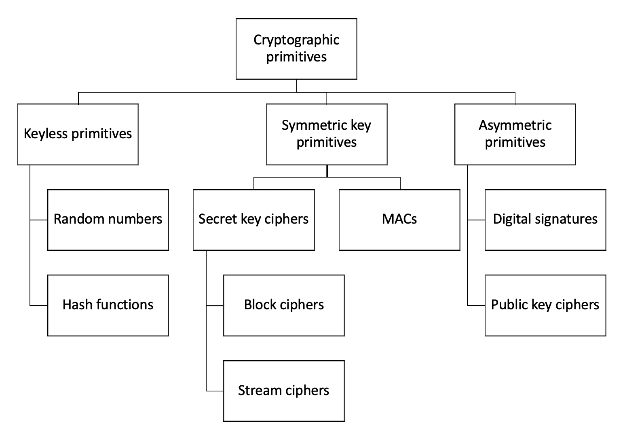
Cryptographic primitives
As shown in the preceding cryptographic primitive taxonomy diagram, cryptography is mainly divided into three categories:
Keyless primitives
Symmetric key primitives/cryptography
Asymmetric key primitives/cryptography

Slide 5
Keyless primitives
Random numbers
RNGs
PRNGs
Hash functions

Slide 6
RNG AND PRNG
A Random Number Generator (RNG) algorithm is a method used to produce a sequence of numbers that appear to be random. There are two main types:
Pseudorandom Number Generators (PRNGs): These are deterministic algorithms that produce a sequence of numbers that appear random but are generated from an initial "seed" value. If the same seed is used, the same sequence of numbers will be generated. A common example is the Linear Congruential Generator (LCG), which uses a formula like:
X_{i+1} = (aX_i + c) mod m
where: X is the sequence of pseudorandom numbers, m is the modulus parameter, a is the multiplier, c is the increment, and X_0 is the initial seed value.

Slide 7
TRNGs
True Random Number Generators (TRNGs): These rely on physical phenomena that are inherently unpredictable and chaotic to generate truly random numbers. Examples include atmospheric noise, radioactive decay, or fluctuations in voltage. These generators are typically hardware-based.

Slide 8
How PRNG algorithms work:
PRNGs start with a seed value. This seed can be derived from various sources like the current time, mouse movements, or other unpredictable system events. The algorithm then applies mathematical operations to this seed to produce the next "random" number in the sequence. The key is that while the numbers appear random, they are entirely determined by the initial seed and the algorithm itself. To ensure a different sequence each time, the seed value is often updated continuously.
Applications:
RNG algorithms are crucial in various fields, including:
Gaming: Ensuring fairness and unpredictability in games like dice rolls, card shuffles, and lottery draws.
Cryptography: Generating keys and other random values for secure communication.
Simulations: Modeling complex systems where random events play a role.
Scientific research: Statistical sampling and data analysis.

Slide 9
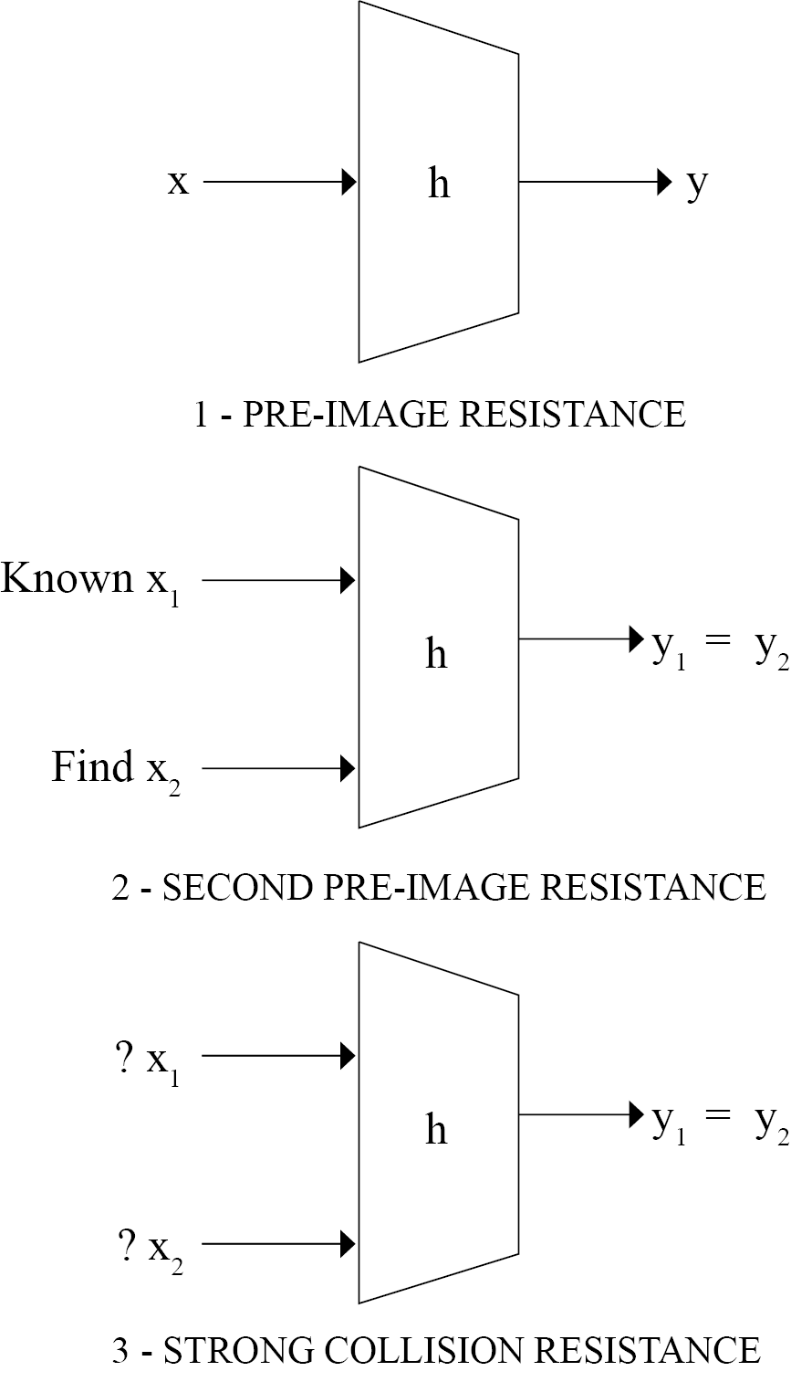
Hash functions
Hash functions compress arbitrary messages into fixed-length digests. They are easy to compute.
The security properties of hash functions are:
Pre-image resistance
Second pre-image resistance
Collision resistance

Slide 10
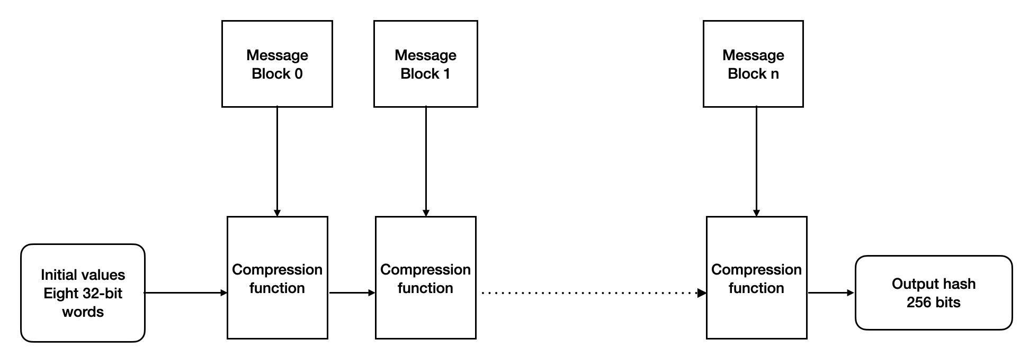
SHA256
As shown in the preceding diagram, SHA-256 takes the input message and divides it into equal blocks of 512 bits. Initial values (or initial hash values) of the initialization vector are composed of eight 32 bit words (256 bits) that are fed into the compression function with the first message. Subsequent blocks are fed into the compression function until all blocks are processed and finally, the output hash is produced.

Slide 11
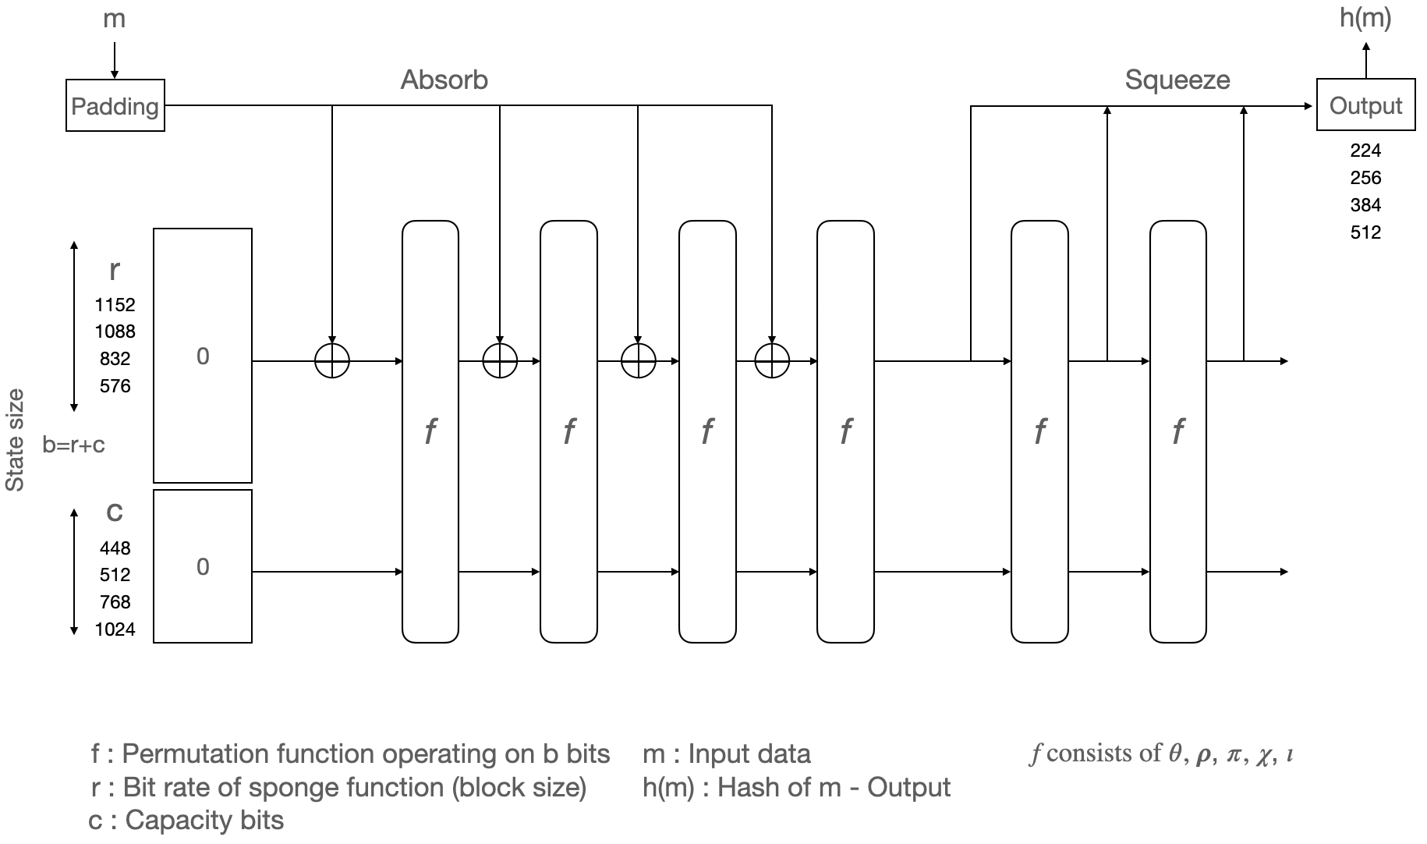
Design of SHA-3 (Keccak)
The diagram shows the sponge and squeeze model, which is the basis of SHA-3 or Keccak.

Slide 12
Key aspects of SHA-3:
Sponge Construction:
This unique design allows SHA-3 to "absorb" input data into a fixed-size internal state and then "squeeze" out a hash value of a desired length. It's like a sponge that can soak up any amount of liquid (data) and then release a specific amount.
Keccak Permutation:
At the core of the sponge construction is the Keccak permutation function, which applies a series of five sub-rounds (theta, rho, pi, chi, and iota) iteratively to the internal state, ensuring thorough mixing and diffusion of the data.

Slide 13
Variable Output Lengths:
SHA-3 supports various hash output lengths, including SHA3-224, SHA3-256, SHA3-384, and SHA3-512, which produce hash values of 224, 256, 384, and 512 bits, respectively.
Extendable-Output Functions (XOFs):
The SHA-3 family also includes SHAKE128 and SHAKE256, which are extendable-output functions. These functions can produce an output of arbitrary length, making them suitable for applications like key derivation and random number generation.
Security Properties:
SHA-3 is designed to provide strong security properties, including collision resistance (making it computationally infeasible to find two different inputs that produce the same hash output) and preimage resistance (making it computationally infeasible to find the input that produced a given hash output).

Slide 14
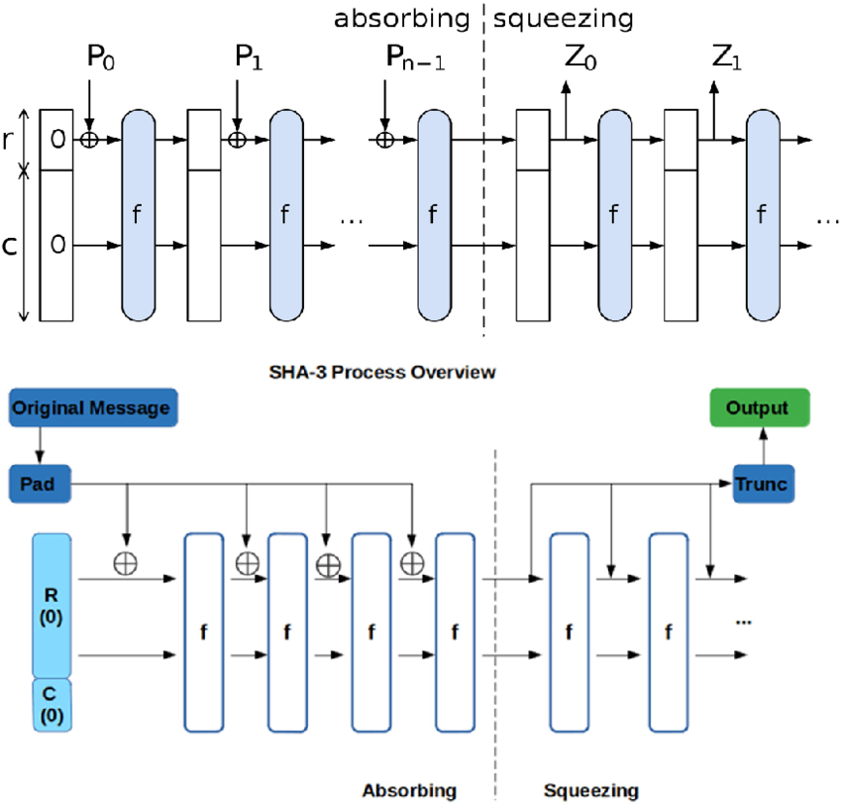

Slide 15
Symmetric cryptography
Uses the same key for encryption and decryption
Types of keys
Public key
Private key
Ephemeral key
Master key

Slide 16
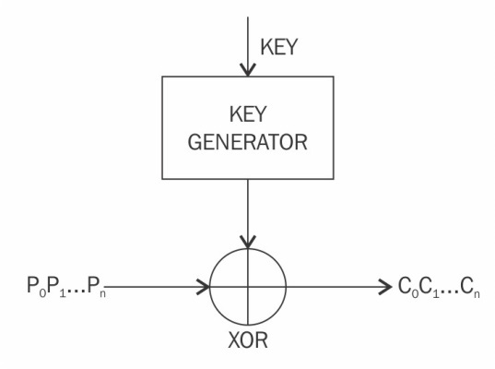
Stream ciphers
Stream ciphers are encryption algorithms that apply encryption algorithms on a bit-by-bit basis (one bit at a time) to plaintext using a keystream.
Operation of a stream cipher

Slide 17
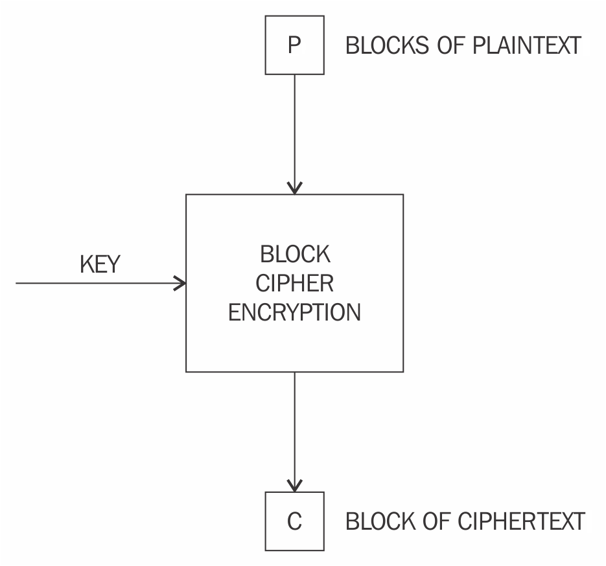
Block ciphers
Block ciphers are encryption algorithms that break up the text to be encrypted (plaintext) into blocks of a fixed length and apply the encryption block by block.
Operation of a block cipher

Slide 18
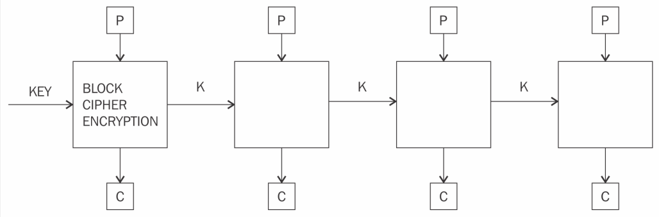
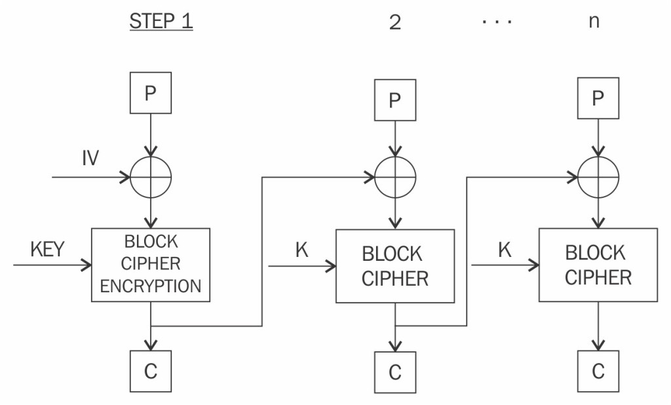
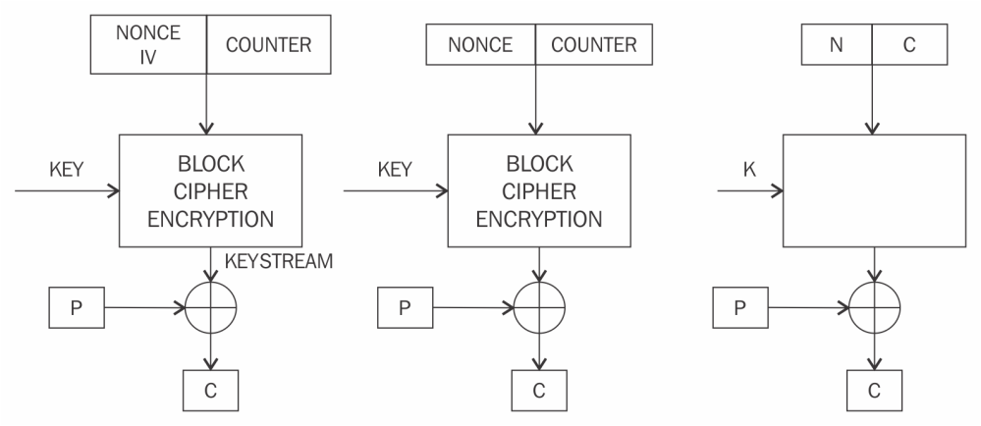
Block encryption modes
Electronic codebook mode
Cipher block chaining mode
Counter mode

Slide 19
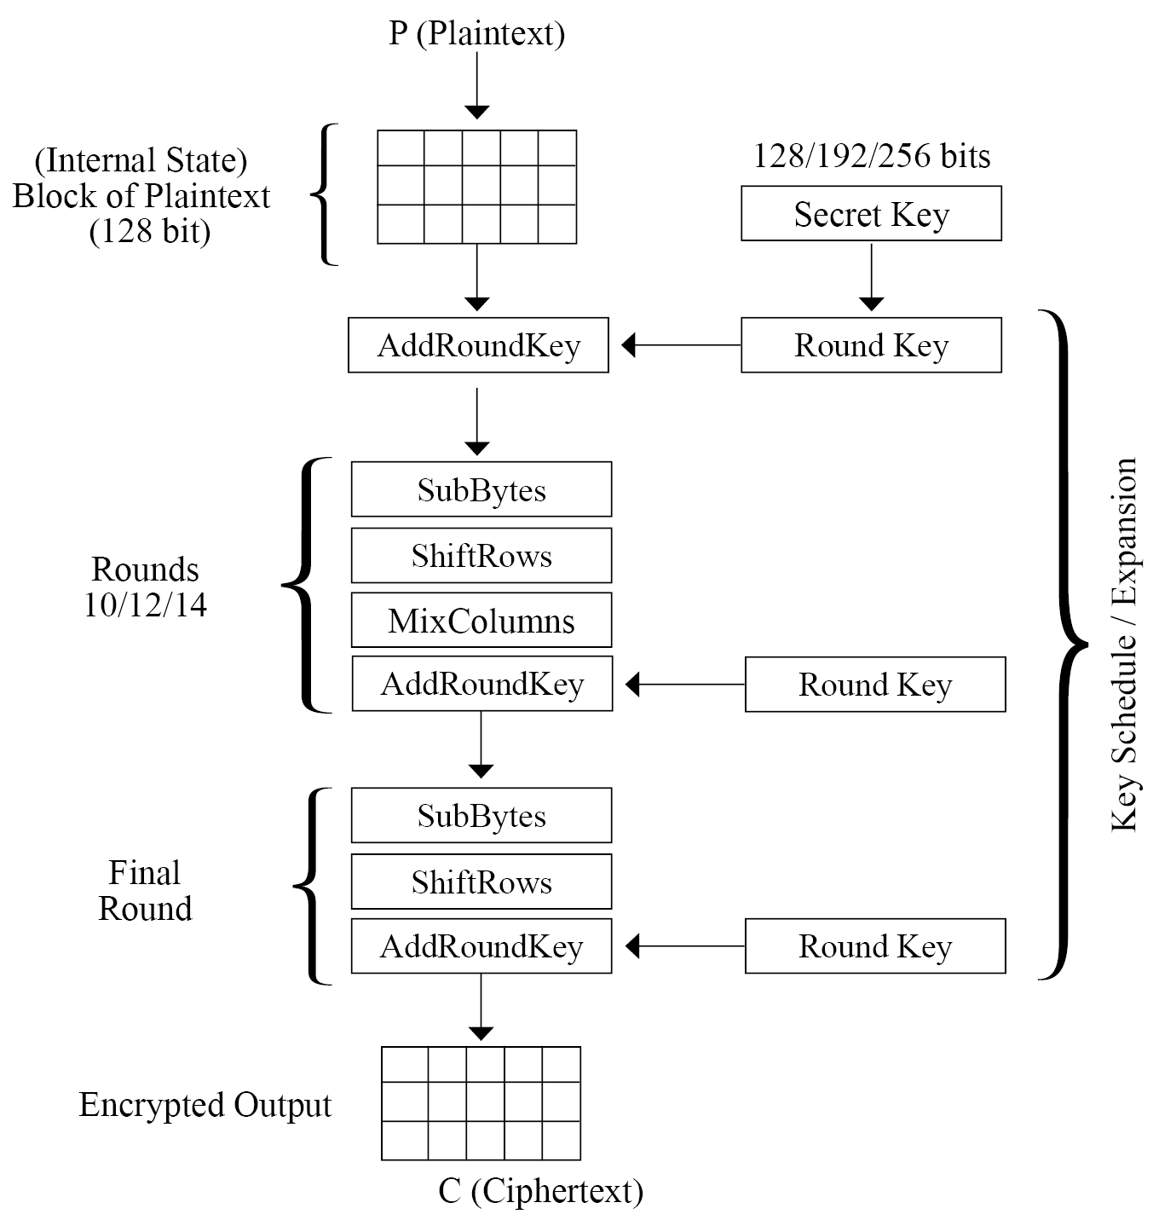
Advanced Encryption Standard (AES)
After state initialization four operations are performed in sequence to encrypt the input:
AddRoundKey: In this step, the state array is XORed with a subkey, which is derived from the master key.
SubBytes: This is the substitution step where a lookup table (S-box) is used to replace all bytes of the state array.
ShiftRows: This step is used to shift each row to the left, except for the first one, in the state array in a cyclic and incremental manner.
MixColumns: Finally, all bytes are mixed in a linear fashion (linear transformation), column-wise.
This is one round of AES. In the final round (either the 10th, 12th, or 14th round, depending on the key size), stage 4 is replaced with AddRoundKey to ensure that the first three steps cannot be simply reversed.

Slide 20
Exercise
Search and find a way to encrypt plaintext into an AES 256-bit encrypted output, using the OpenSSL command line tool.

Slide 21
Summary
In this presentation, we…
Explored symmetric key cryptography.
Considered some cryptographic primitives.
Looked at stream and block ciphers.
Covered the working modes of block ciphers.
Learned about AES

